Slide 1

MINI PROJECT PRESENTATION
“ SMART DOORBELL FACIAL VERIFICATION USING GENERATIVE ADVERSARIAL NETWORK”
SUBMITTED BY
ARKO KUNDU ROLL NO: 10200323055
PIYAS SASMAL ROLL NO: 10200322063
SWARUP MONDAL ROLL NO:10200323074
SAMIR HALDER ROLL NO:10200323067
6th Semester Electronics and Communication Engineering
KALYANI GOVERNMENT ENGINEERING COLLEGE
Under the guidance of
MR. ANUP KUMAR MALLICK
DATE:
16/06/2025

Slide 2




Our Team
2
ARKO KUNDU
SAMIR HALDER
PIYAS SASMAL
SWARUP MONDAL

Slide 3
Presentation Flow
3
PROJECT OVERVIEW
EXPLANATION
RESULTS AND OUTCOMES
GOALS
CONCLUSION
Flowchart-2
WORKING
Flowchart-1
APPLICATIONS
BUILDING THE MODEL
PRE-PROCESSING
FUTURE ADVANCEMENTS
REFERENCES

Slide 4
Project Overview
4
Innovative security solution
Integrating Deep Convolutional Generative Adversarial Networks(D. Kim et al [5])
Facial authentication(T. S. Sivakami et al [3])
Pytorch for Deep Learning
Flask for web application development
OpenCV for real-time image processing(S. Malve et al [2])

Slide 5
Project Goals
5
DCGAN Architecture(M. Manimegala et al.[1])
Distinguishing between authorized and unknown users
Higher accuracy
Comprehensive Real-time face detection(J. Upadhyay et al[4])
Computer Vision algorithms
Haar Cascade classifiers
01
02
Threshold-based access system
Security level customization
Risk tolerance
Regularization techniques
Model generalization
Overfit prevention
03
04

Slide 6
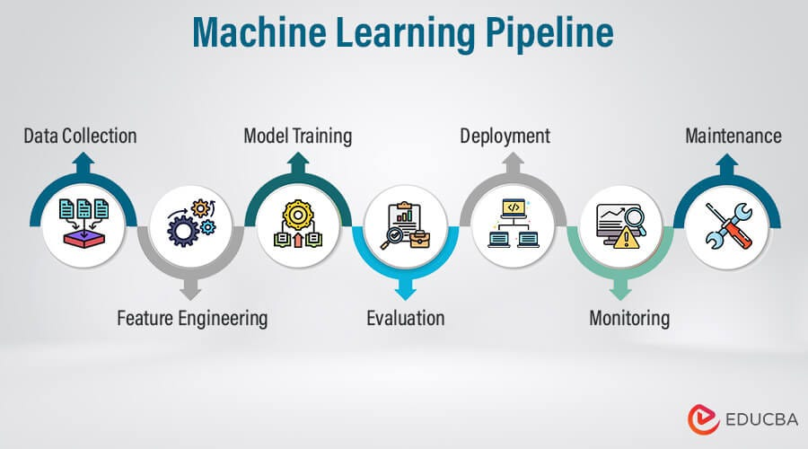
6
Project Workflow
PROCESSING PIPELINE
Image Acquisition
Face Detection
Preprocessing
Verification
Decision
MACHINE LEARNING ARCHITECTURE
DCGAN Discriminator
Feature Extraction
Training
Regularization
Fig. 1. Machine Learning Pipeline [7]

Slide 7
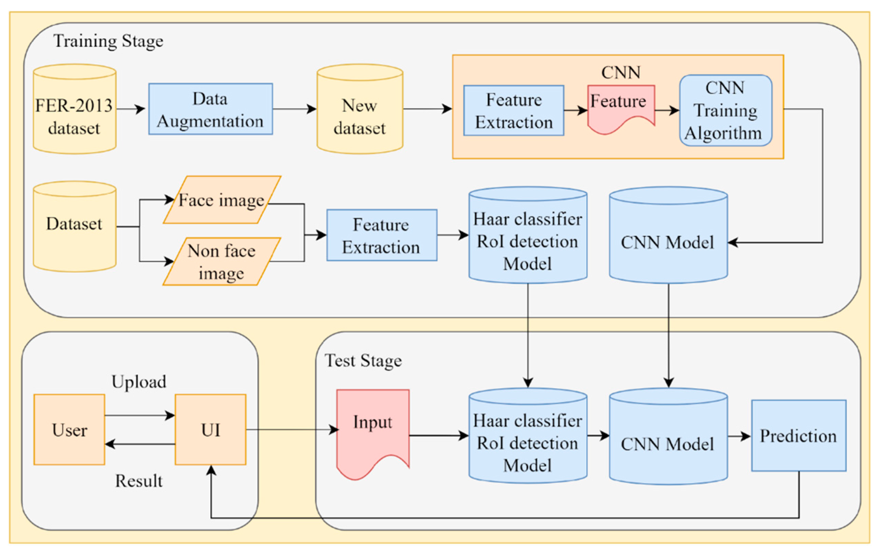
System framework using CNN and Haar Cascade
7
Fig. 2. System framework [6]

Slide 8
Model Building
8
DISCRIMINATOR
GENERATOR
Receive real or generated images.
Pass images through convolutional layers.
Apply batch normalization and LeakyReLU.
Output probability via sigmoid function.
Compute loss against true labels.
Update weights using backpropagation
Take random noise as input.
Upsample through transposed convolutions.
Apply batch normalization and ReLU.
Output image with Tanh activation.
Pass image to discriminator.
Update weights to fool discriminator.

Slide 9
Image Preprocessing
9
Receive image input (camera/file).
Convert image to numpy array.
Change RGB to BGR format.
Convert image to grayscale.
Load Haar Cascade face detector.
Detect faces in grayscale image.
If face found, pick largest face.
Expand face region by 20%.
Crop image to face region.
If no face, center crop image.
Convert cropped image to RGB.
Convert array to PIL Image.
Resize image to 64x64 pixels.
Convert image to tensor format.
Normalize tensor to [-1, 1].
Return tensor and face detected flag.

Slide 10
10
Training Phase
Validation Phase
Shuffle and load training batch.
Move images and labels to device.
Set discriminator and generator to train.
Create real and fake label tensors.
Zero discriminator gradients.
Generate fake images from noise.
Compute discriminator output for real images.
Compute discriminator output for fake images.
Calculate discriminator loss (real + fake).
Backpropagate and update discriminator weights.
Zero generator gradients.
Generate new fake images from noise.
Compute discriminator output for fake images.
Calculate generator loss (target real).
Backpropagate and update generator weights.
Accumulate losses for reporting.
Set models to evaluation mode.
Initialize validation loss accumulator.
Loop over validation data batches.
Move images and labels to device.
Disable gradients (no backpropagation).
Compute discriminator output for images.
Calculate validation loss (BCE).
Accumulate validation loss.
Count correct predictions for accuracy.
Compute average validation loss.
Calculate validation accuracy.
Log or store validation results.

Slide 11
11
Key Concepts
Model Architecture
Labelling of Persons
Supervised learning framework
Data Augmentation Techniques
Preventing Overfitting
LeakyReLU
Batch Normalization
Sigmoid Function
Verification Probability

Slide 12
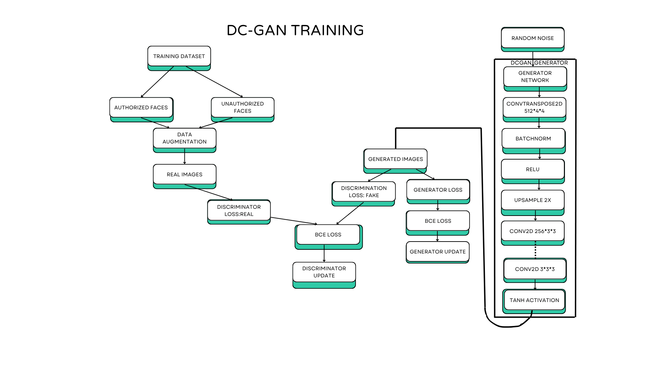
Flowchart of the Training Model
12
Fig. 3. Flowchart of training model

Slide 13
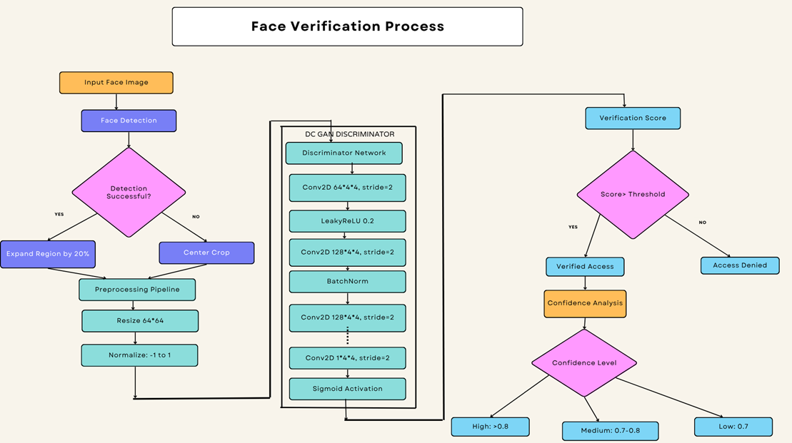
Flowchart of Face Verification Process
13
Fig. 4. Flowchart of face verification process

Slide 14
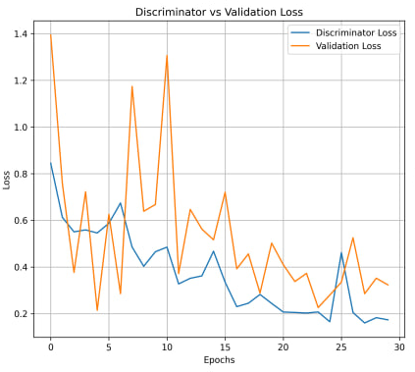
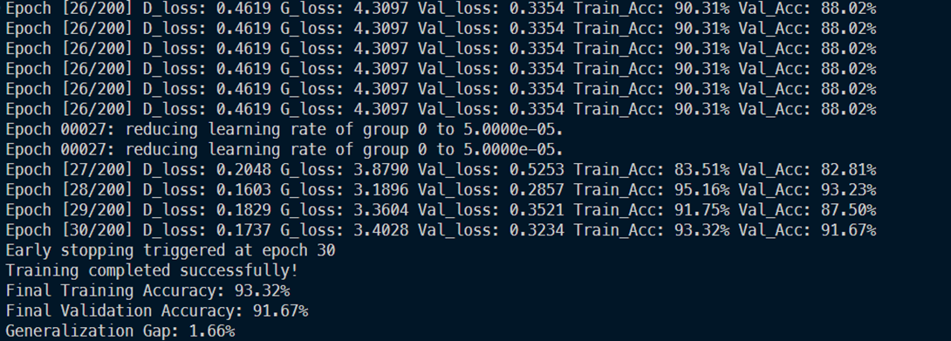
Results and Outcomes
14
Training and Validation accuracy along with reduction of learning rate and early stopping
Fig. 5. Plotting of losses through DCGAN

Slide 15
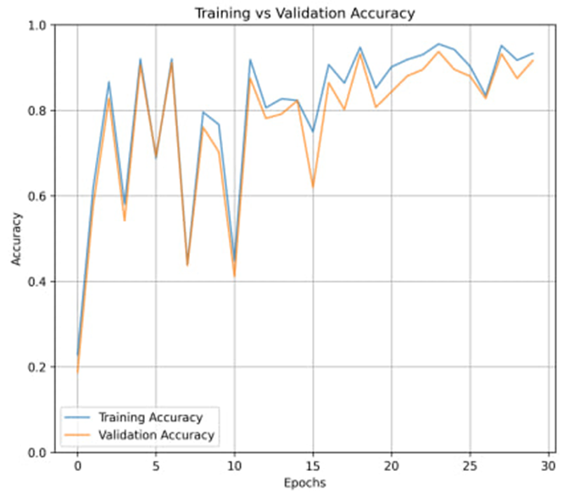
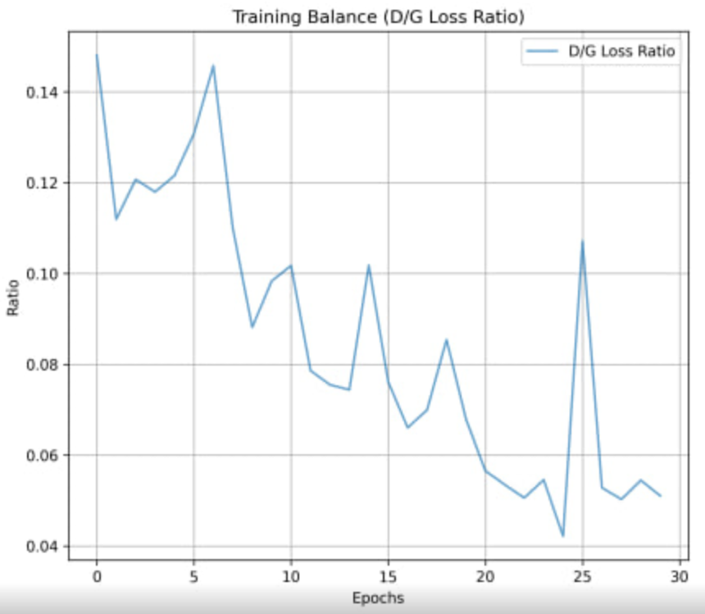
Results and Outcomes
15
Fig. 6. Plotting of Training losses through DCGAN
Fig. 7. Plotting of Training Balance( D/G Loss Ratio)

Slide 16
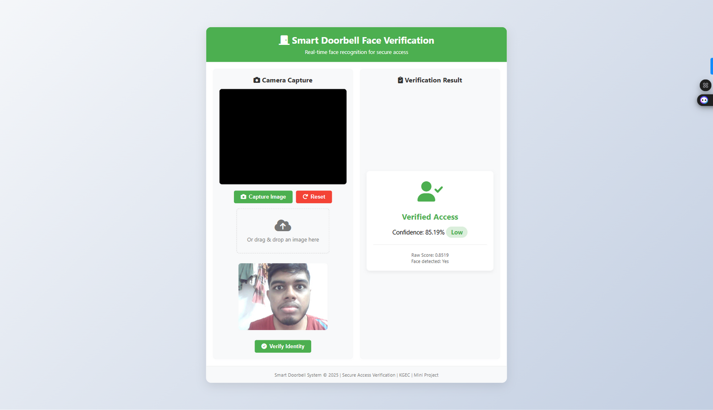
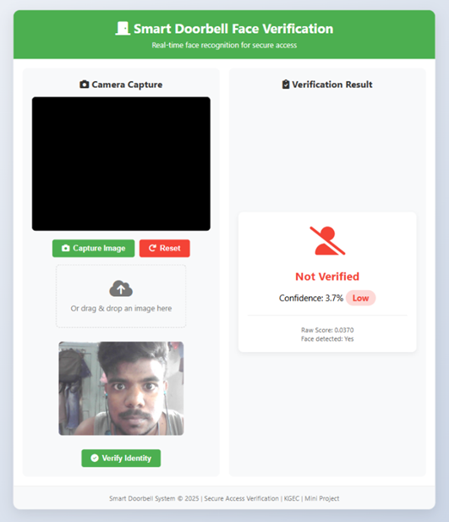
Results and Outcomes
16
Fig. 8. Verified Access
Fig. 9. Not Verified Access

Slide 17

Conclusion
17
Implementation of a comprehensive facial verification system
Combines Deep Learning techniques
Web Application Development
Robust Verification
Stable architecture

Slide 18
18
Residential Security Applications
Commercial and Institutional Applications
Applications
Hospitality and Service Industry Applications
Emergency and Public Safety Applications

Slide 19
Future Advancements
19
01
Using Pre trained transformer model from Hugging Face or Open Source.
02
Multi-Modal AI Fusion with Contextual Authentication
03
AI-Powered 3D Liveness Detection and Anti-Spoofing Technology
04
Blockchain-Integrated Decentralized Biometric Storage

Slide 20
References
20
[1] M. Manimegala, V. Gokulraj, K. Karisni, and S. Manisha, “Generating human face with DCGAN and GAN,” Int. Res. J. Adv. Eng. Sci. (IRJAES), vol. 2, no. 5, pp. 1348–1354, 2022.
[2] S. Malve and S. S. Morade, “Face recognition technology based smart doorbell system using Python’s OpenCV library,” Int. J. Eng. Res. & Technol. (IJERT), vol. 10, no. 6, pp. 1–5, 2021.
[3] T. S. Sivakami, J. M. Binoy, A. Jose, and H. Vijay, “Bell Buddy: A dual‑mode IoT‑based smart doorbell with real‑time facial recognition and intruder alert system,” Int. J. Comput. Sci. & Eng. (IJCSE), vol. 11, no. 3, pp. 1–5, 2023.
[4] J. Upadhyay, P. Rida, S. Gupta, and N. Siddique, “Smart Doorbell System based on Face Recognition,” Int. Res. J. Eng. & Technol. (IRJET), vol. 4, no. 3, pp. 2395–2400, Mar. 2017.
[5] D. Kim, H. U. Jang, S. M. Mun, S. Choi, and H. K. Lee, “Median filtered image restoration and anti‑forensics using adversarial networks,” IEEE Signal Process. Lett., vol. 25, no. 2, pp. 278–282, Feb. 2018, doi: 10.1109/LSP.2017.2782363.
[6] J.-F. Yeh, K.-M. Lin, C.-C. Chang, and T.-H. Wang, "Expression Recognition of Multiple Faces Using a Convolution Neural Network Combining the Haar Cascade Classifier," Appl. Sci., vol. 13, no. 23, p. 12737, Nov. 2023.
[7] https://cdn.educba.com/academy/wp-content/uploads/2024/03/Machine-Learning-Pipeline.jpg

Slide 21

21
Thank you
FOR YOUR ATTENTION

